Slide 1
UNIT 3
Dynamic Programming
General Strategy
0/1 Knapsack
Multistage Graph
Single Source Shortest Path(Bellman Ford Algorithm)
All Pair Shortest Path(Floyd Warshalls Algorithm)
Travelling Salesman Problem
Longest Common Subsequence Problem

Slide 2
Dynamic programming
Typically used for Optimization Problem.
Dynamic programming, like the divide-and-conquer method, solves problems by combining the solutions to subproblems.
A dynamic-programming algorithm solves each subproblem just once and then saves its answer in a table.

Slide 3
Elements of Dynamic Programming
Optimal Substructure
Overlapping Subproblems
Memorization
Reconstruction of Optimal Solution

Slide 4
Dynamic Programming

Slide 6
Steps in Dynamic Programming

Slide 7
Elements of Dynamic Programming

Slide 10
Disadvantage of Dijkshtra’s Shortest Path Algorithm
It is only for positive weights
If negative weight in the path then shortest path may be incorrect.

Slide 11
All Pairs Shortest Path Algorithm Floyd Warshall Algorithm
The all pair shortest path algorithm is also known as Floyd-Warshall algorithm is used to find all pair shortest path problem from a given weighted graph.
It uses Dynamic programming formulation on a directed graph G (V, E).
As a result of this algorithm, it will generate a matrix, which will represent the minimum distance from any node to all other nodes in the graph.
At first the output matrix is same as given cost matrix of the graph.
After that the output matrix will be updated with all vertices k as the intermediate vertex.
The time complexity of this algorithm is O(V3), here V is the number of vertices in the graph.
We assume that there are no negative weight cycles.

Slide 12
All Pairs Shortest Path Algorithm Floyd Warshall Algorithm
floydWarshal(cost or weight)
Input − The cost matrix of given Graph.
Output − Matrix to for shortest path between any vertex to any vertex.

Slide 13
Analysis of Floyd Warshall Algorithm
The running time of the Floyd-Warshall algorithm is easy to analyze.
The main loop is executed n times and
The inner loop considers each of O(n2) pairs of vertices, performing a constant-time computation for each pair.
If we use a data structure, such as the adjacency matrix structure, that supports methods are Adjacent and insert Directed Edge in O(1) time,
Total running time is O(n3).

Slide 14
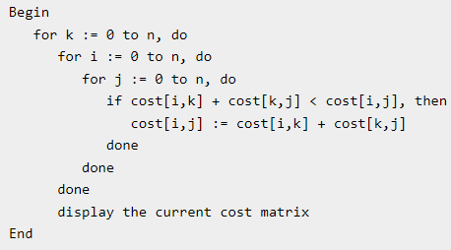
All Pairs Shortest Path Algorithm Floyd Warshall Algorithm for Practical
floydWarshal(cost)
Input − The cost matrix of given Graph.
Output − Matrix to for shortest path between any vertex to any vertex.

Slide 15
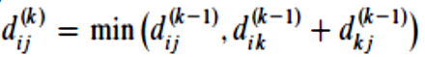
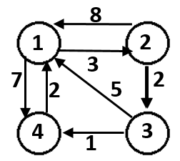

Slide 20

 | 1 | 2 | 3 | 4
1 | 0 | 3 | ∞ | 7
2 | 8 | 0 | 2 | ∞
3 | 5 | ∞ | 0 | 1
4 | 2 | ∞ | ∞ | 0
8
1
2
3
7
2
2
5
4
3
1
 | 1 | 2 | 3 | 4
1 | 0 | 3 | ∞ | 7
2 | 8 | 0 | 2 | ∞
3 | 5 | ∞ | 0 | 1
4 | 2 | ∞ | ∞ | 0
A0

Slide 21
 | 1 | 2 | 3 | 4
1 | 0 | 3 | ∞ | 7
2 | 8 | 0 | 2 | ∞
3 | 5 | ∞ | 0 | 1
4 | 2 | ∞ | ∞ | 0
A0 =
A1 =
 | 1 | 2 | 3 | 4
1 | 0 | 3 | ∞ | 7
2 | 8 | 0
3 | 5 |  | 0
4 | 2 |  |  | 0

Slide 22
A0 =
A1[2.3] A0[2,1] + A0[1,3]
2 8 + ∞ = ∞
A1 =
 | 1 | 2 | 3 | 4
1 | 0 | 3 | ∞ | 7
2 | 8 | 0 | 2 | ∞
3 | 5 | ∞ | 0 | 1
4 | 2 | ∞ | ∞ | 0
 | 1 | 2 | 3 | 4
1 | 0 | 3 | ∞ | 7
2 | 8 | 0 | 2
3 | 5 |  | 0
4 | 2 |  |  | 0

Slide 23
A0 =
A1[2,3] A0[2,1] + A0[1,3]
2 8 + ∞ = ∞
A1[2,4] A0[2,1] + A0[1,4]
∞ 8 + 7 = 15
A1 =
 | 1 | 2 | 3 | 4
1 | 0 | 3 | ∞ | 7
2 | 8 | 0 | 2 | ∞
3 | 5 | ∞ | 0 | 1
4 | 2 | ∞ | ∞ | 0
 | 1 | 2 | 3 | 4
1 | 0 | 3 | ∞ | 7
2 | 8 | 0 | 2 | 15
3 | 5 |  | 0
4 | 2 |  |  | 0

Slide 24
A0 =
A1[2,3] A0[2,1] + A0[1,3]
2 8 + ∞ = ∞
A1[2,4] A0[2,1] + A0[1,4]
∞ 8 + 7 = 15
A1 = A1[3,2] A0[3,1] + A0[1,2]
∞ 5 + 3 = 8
 | 1 | 2 | 3 | 4
1 | 0 | 3 | ∞ | 7
2 | 8 | 0 | 2 | ∞
3 | 5 | ∞ | 0 | 1
4 | 2 | ∞ | ∞ | 0
 | 1 | 2 | 3 | 4
1 | 0 | 3 | ∞ | 7
2 | 8 | 0 | 2 | 15
3 | 5 | 8 | 0
4 | 2 |  |  | 0

Slide 25
A0 =
A1[2,3] A0[2,1] + A0[1,3]
2 8 + ∞ = ∞
A1[2,4] A0[2,1] + A0[1,4]
∞ 8 + 7 = 15
A1 = A1[3,2] A0[3,1] + A0[1,2]
∞ 5 + 3 = 8
A1[3,4] A0[3,1] + A0[1,4]
1 5 + 7 = 12
 | 1 | 2 | 3 | 4
1 | 0 | 3 | ∞ | 7
2 | 8 | 0 | 2 | ∞
3 | 5 | ∞ | 0 | 1
4 | 2 | ∞ | ∞ | 0
 | 1 | 2 | 3 | 4
1 | 0 | 3 | ∞ | 7
2 | 8 | 0 | 2 | 15
3 | 5 | 8 | 0 | 1
4 | 2 |  |  | 0

Slide 26
A0 =
A1[2,3] A0[2,1] + A0[1,3]
2 8 + ∞ = ∞
A1[2,4] A0[2,1] + A0[1,4]
∞ 8 + 7 = 15
A1 = A1[3,2] A0[3,1] + A0[1,2]
∞ 5 + 3 = 8
A1[3,4] A0[3,1] + A0[1,4]
1 5 + 7 = 12
A1[4,2] A0[4,1] + A0[1,2]
∞ 2 + 3 = 5
 | 1 | 2 | 3 | 4
1 | 0 | 3 | ∞ | 7
2 | 8 | 0 | 2 | ∞
3 | 5 | ∞ | 0 | 1
4 | 2 | ∞ | ∞ | 0
 | 1 | 2 | 3 | 4
1 | 0 | 3 | ∞ | 7
2 | 8 | 0 | 2 | 15
3 | 5 | 8 | 0 | 1
4 | 2 | 5 |  | 0

Slide 27
A0 =
A1[2,3] A0[2,1] + A0[1,3]
2 8 + ∞ = ∞
A1[2,4] A0[2,1] + A0[1,4]
∞ 8 + 7 = 15
A1 = A1[3,2] A0[3,1] + A0[1,2]
∞ 5 + 3 = 8
A1[3,4] A0[3,1] + A0[1,4]
1 5 + 7 = 12
A1[4,2] A0[4,1] + A0[1,2]
∞ 2 + 3 = 5
A1[4,3] A0[4,1] + A0[1,3]
∞ 2 + ∞ = ∞
 | 1 | 2 | 3 | 4
1 | 0 | 3 | ∞ | 7
2 | 8 | 0 | 2 | ∞
3 | 5 | ∞ | 0 | 1
4 | 2 | ∞ | ∞ | 0
 | 1 | 2 | 3 | 4
1 | 0 | 3 | ∞ | 7
2 | 8 | 0 | 2 | 15
3 | 5 | 8 | 0 | 1
4 | 2 | 5 | ∞ | 0

Slide 28
 | 1 | 2 | 3 | 4
1 | 0 | 3 | ∞ | 7
2 | 8 | 0 | 2 | 15
3 | 5 | 8 | 0 | 1
4 | 2 | 5 | ∞ | 0
A1 =
A2 =
 | 1 | 2 | 3 | 4
1 | 0 | 3
2 | 8 | 0 | 2 | 15
3 |  | 8 | 0
4 |  | 5 |  | 0

Slide 29
 | 1 | 2 | 3 | 4
1 | 0 | 3 | ∞ | 7
2 | 8 | 0 | 2 | 15
3 | 5 | 8 | 0 | 1
4 | 2 | 5 | ∞ | 0
A1 =
A2[1,3] A1[1,2] + A1[2,3]
∞ 3 + 2 = 5
A2 =
 | 1 | 2 | 3 | 4
1 | 0 | 3 | 5
2 | 8 | 0 | 2 | 15
3 |  | 8 | 0
4 |  | 5 |  | 0

Slide 30
 | 1 | 2 | 3 | 4
1 | 0 | 3 | ∞ | 7
2 | 8 | 0 | 2 | 15
3 | 5 | 8 | 0 | 1
4 | 2 | 5 | ∞ | 0
A1 =
A2[1,3] A1[1,2] + A1[2,3]
∞ 3 + 2 = 5
A2[1,4] A1[1,2] + A1[2,4]
7 3 + 15 = 18
A2 =
 | 1 | 2 | 3 | 4
1 | 0 | 3 | 5 | 7
2 | 8 | 0 | 2 | 15
3 |  | 8 | 0
4 |  | 5 |  | 0

Slide 31
 | 1 | 2 | 3 | 4
1 | 0 | 3 | ∞ | 7
2 | 8 | 0 | 2 | 15
3 | 5 | 8 | 0 | 1
4 | 2 | 5 | ∞ | 0
A1 =
A2[1,3] A1[1,2] + A1[2,3]
∞ 3 + 2 = 5
A2[1,4] A1[1,2] + A1[2,4]
7 3 + 15 = 18
A2 = A2[3,1] A1[3,2] + A1[2,1]
5 8 + 8 = 16
 | 1 | 2 | 3 | 4
1 | 0 | 3 | 5 | 7
2 | 8 | 0 | 2 | 15
3 | 5 | 8 | 0
4 |  | 5 |  | 0

Slide 32
 | 1 | 2 | 3 | 4
1 | 0 | 3 | ∞ | 7
2 | 8 | 0 | 2 | 15
3 | 5 | 8 | 0 | 1
4 | 2 | 5 | ∞ | 0
A1 =
A2[1,3] A1[1,2] + A1[2,3]
∞ 3 + 2 = 5
A2[1,4] A1[1,2] + A1[2,4]
7 3 + 15 = 18
A2 = A2[3,1] A1[3,2] + A1[2,1]
5 8 + 8 = 16
A2[3,4] A1[3,2] + A1[2,4]
1 8 + 15 = 23
 | 1 | 2 | 3 | 4
1 | 0 | 3 | 5 | 7
2 | 8 | 0 | 2 | 15
3 | 5 | 8 | 0 | 1
4 |  | 5 |  | 0

Slide 33
 | 1 | 2 | 3 | 4
1 | 0 | 3 | ∞ | 7
2 | 8 | 0 | 2 | 15
3 | 5 | 8 | 0 | 1
4 | 2 | 5 | ∞ | 0
A1 =
A2[1,3] A1[1,2] + A1[2,3]
∞ 3 + 2 = 5
A2[1,4] A1[1,2] + A1[2,4]
7 3 + 15 = 18
A2 = A2[3,1] A1[3,2] + A1[2,1]
5 8 + 8 = 16
A2[3,4] A1[3,2] + A1[2,4]
1 8 + 15 = 23
A2[4,1] A1[4,2] + A1[2,1]
2 5 + 8 = 13
A2[4,3] A1[4,2] + A1[2,3]
∞ 5 + 2 = 7
 | 1 | 2 | 3 | 4
1 | 0 | 3 | 5 | 7
2 | 8 | 0 | 2 | 15
3 | 5 | 8 | 0 | 1
4 | 2 | 5 | 7 | 0

Slide 34
A3 =
A4 =
 | 1 | 2 | 3 | 4
1 | 0 | 3 | 5 | 6
2 | 7 | 0 | 2 | 3
3 | 5 | 8 | 0 | 1
4 | 2 | 5 | 7 | 0
 | 1 | 2 | 3 | 4
1 | 0 | 3 | 5 | 6
2 | 5 | 0 | 2 | 3
3 | 3 | 6 | 0 | 1
4 | 2 | 5 | 7 | 0

Slide 35
A3 =
A4 =
 | 1 | 2 | 3 | 4
1 | 0 | 3 | 5 | 6
2 | 7 | 0 | 2 | 3
3 | 5 | 8 | 0 | 1
4 | 2 | 5 | 7 | 0
 | 1 | 2 | 3 | 4
1 | 0 | 3 | 5 | 6
2 | 5 | 0 | 2 | 3
3 | 3 | 6 | 0 | 1
4 | 2 | 5 | 7 | 0

Slide 36
 | 1 | 2 | 3 | 4
1 | 0 | 3 | ∞ | 7
2 | 8 | 0 | 2 | 15
3 | 5 | 8 | 0 | 1
4 | 2 | 5 | ∞ | 0
 | 1 | 2 | 3 | 4
1 | 0 | 3 | 5 | 6
2 | 7 | 0 | 2 | 3
3 | 5 | 8 | 0 | 1
4 | 2 | 5 | 7 | 0
A1 = A3 =
A2 = A4 =
 | 1 | 2 | 3 | 4
1 | 0 | 3 | 5 | 7
2 | 8 | 0 | 2 | 15
3 | 5 | 8 | 0 | 1
4 | 2 | 5 | 7 | 0
 | 1 | 2 | 3 | 4
1 | 0 | 3 | 5 | 6
2 | 5 | 0 | 2 | 3
3 | 3 | 6 | 0 | 1
4 | 2 | 5 | 7 | 0

Slide 37
 | 1 | 2 | 3 | 4
1 | 0 | 3 | 5 | 6
2 | 5 | 0 | 2 | 3
3 | 3 | 6 | 0 | 1
4 | 2 | 5 | 7 | 0
A4 =

Slide 38
Multistage Graph
A Multistage graph is a directed, weighted graph.
nodes can be divided into a set of stages such that all edges are from a stage to next stage only (there is no edge between vertices of same stage and from a vertex of current stage to previous stage).
The vertices of a multistage graph are divided into n number of disjoint subsets S = { S₁ , S_{2 ,} S_{3 ………..} S_{n} }, where S₁ is the source and S_{n} is the sink ( destination ).
The cardinality of S₁ and S_{n} are equal to 1. |S₁| = |S_{n}| = 1.
We are given a multistage graph, a source and a destination, we need to find shortest path from source to destination. By convention, we consider source at stage 1 and destination as last stage.

Slide 39
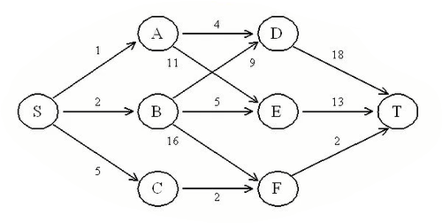

Slide 43
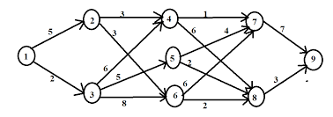

Slide 46
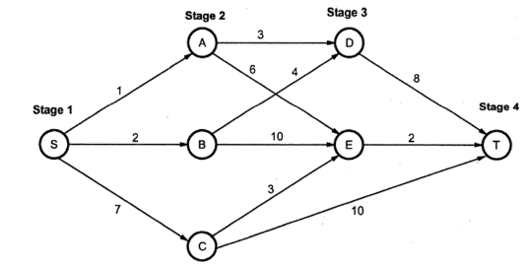
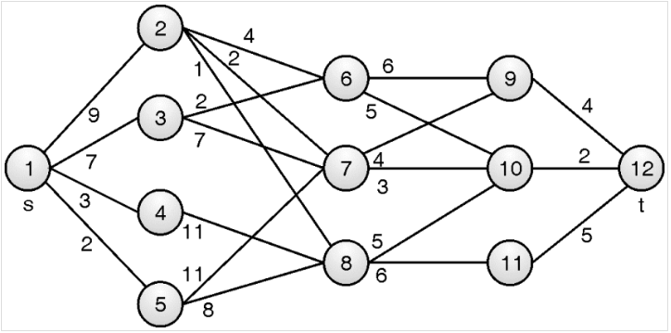
Examples for HW

Slide 47
Longest Common Subsequence

Slide 48
Example – Find out longest common subsequence for X - { B, C, A, D, F, E } Y – { A, B, C, D, E }
String 1 - { B, C, A, D, F, E }
String 2 – { A, B, C, D, E }
B C A D F E
Sol – { }
A B C D E

Slide 49
String 1 - { B, C, A, D, F, E }
String 2 – { A, B, C, D, E }
B C A D F E
Sol – { }
A B C D E

Slide 50
String 1 - { B, C, A, D, F, E }
String 2 – { A, B, C, D, E }
B C A D F E
Sol – { }
A B C D E

Slide 51
String 1 - { B, C, A, D, F, E }
String 2 – { A, B, C, D, E }
B C A D F E
Sol – { A }
A B C D E

Slide 52
String 1 - { B, C, A, D, F, E }
String 2 – { A, B, C, D, E }
B C A D F E
Sol – { A }
A B C D E
Not in sequence hence rejected

Slide 53
String 1 - { B, C, A, D, F, E }
String 2 – { A, B, C, D, E }
B C A D F E
Sol – { A }
A B C D E
Not in sequence hence rejected

Slide 54
String 1 - { B, C, A, D, F, E }
String 2 – { A, B, C, D, E }
B C A D F E
Sol – { A, D }
A B C D E

Slide 55
String 1 - { B, C, A, D, F, E }
String 2 – { A, B, C, D, E }
B C A D F E
Sol – { A, D, E }
A B C D E

Slide 56
String 1 - { B, C, A, D, F, E }
String 2 – { A, B, C, D, E }
B C A D F E
Sol – { B, C, D, E }
A B C D E
Sol 2 – start from next character i.e. B in string 2

Slide 57
String 1 - { B, C, A, D, F, E }
String 2 – { A, B, C, D, E }
B C A D F E
Sol – { B, C, D, E }
A B C D E
Sol 2 – start from next character i.e. B in string 2

Slide 58
String 1 - { B, C, A, D, F, E }
String 2 – { A, B, C, D, E }
B C A D F E
Sol – { B, C, D, E }
A B C D E
Sol 2 – start from next character i.e. B in string 2

Slide 59
String 1 - { B, C, A, D, F, E }
String 2 – { A, B, C, D, E }
B C A D F E
Sol – { B, C, D, E }
A B C D E
Sol 2 – start from next character i.e. B in string 2
Similarly find remaining solutions :
{A,D,E} 2. {B,C,D,E} 3. {C,D,E} 4. {D,E}
LCS is {B,C,D,E} with length 4

Slide 60
String 1 - { longest }
String 2 – { stone }
l o n g e s t
Sol – { O, N, E }
s t o n e
Similarly find remaining solutions :
{s, t} 2. {o, n, e} 3. {n, e}
LCS is {o, n, ,e} with length 3

Slide 63
Example – Find out longest common subsequence for
X= { A, B, C, B, D, A, B } Y={ B, D, C, A, B, A }
 | j | 0 | 1 | 2 | 3 | 4 | 5 | 6
i |  |  | B | D | C | A | B | A
0
1 | A
2 | B
3 | C
4 | B
5 | D
6 | A
7 | B

Slide 64
Example – Find out longest common subsequence for
X= { A, B, C, B, D, A, B } Y={ B, D, C, A, B, A }
 | j | 0 | 1 | 2 | 3 | 4 | 5 | 6
i |  |  | B | D | C | A | B | A
0 |  | 0 | 0 | 0 | 0 | 0 | 0 | 0
1 | A | 0
2 | B | 0
3 | C | 0
4 | B | 0
5 | D | 0
6 | A | 0
7 | B | 0

Slide 65
 | j | 0 | 1 | 2 | 3 | 4 | 5 | 6
i |  |  | B | D | C | A | B | A
0 |  | 0 | 0 | 0 | 0 | 0 | 0 | 0
1 | A | 0
2 | B | 0
3 | C | 0
4 | B | 0
5 | D | 0
6 | A | 0
7 | B | 0

Slide 66
 | j | 0 | 1 | 2 | 3 | 4 | 5 | 6
i |  |  | B | D | C | A | B | A
0 |  | 0 | 0 | 0 | 0 | 0 | 0 | 0
1 | A | 0 | 0
2 | B | 0
3 | C | 0
4 | B | 0
5 | D | 0
6 | A | 0
7 | B | 0

Slide 67
 | j | 0 | 1 | 2 | 3 | 4 | 5 | 6
i |  |  | B | D | C | A | B | A
0 |  | 0 | 0 | 0 | 0 | 0 | 0 | 0
1 | A | 0 | 0 | 0
2 | B | 0
3 | C | 0
4 | B | 0
5 | D | 0
6 | A | 0
7 | B | 0

Slide 68
 | j | 0 | 1 | 2 | 3 | 4 | 5 | 6
i |  |  | B | D | C | A | B | A
0 |  | 0 | 0 | 0 | 0 | 0 | 0 | 0
1 | A | 0 | 0 | 0 | 0
2 | B | 0
3 | C | 0
4 | B | 0
5 | D | 0
6 | A | 0
7 | B | 0

Slide 69
 | j | 0 | 1 | 2 | 3 | 4 | 5 | 6
i |  |  | B | D | C | A | B | A
0 |  | 0 | 0 | 0 | 0 | 0 | 0 | 0
1 | A | 0 | 0 | 0 | 0 | 1
2 | B | 0
3 | C | 0
4 | B | 0
5 | D | 0
6 | A | 0
7 | B | 0

Slide 70
 | j | 0 | 1 | 2 | 3 | 4 | 5 | 6
i |  |  | B | D | C | A | B | A
0 |  | 0 | 0 | 0 | 0 | 0 | 0 | 0
1 | A | 0 | 0 | 0 | 0 | 1 | 1
2 | B | 0
3 | C | 0
4 | B | 0
5 | D | 0
6 | A | 0
7 | B | 0

Slide 71
 | j | 0 | 1 | 2 | 3 | 4 | 5 | 6
i |  |  | B | D | C | A | B | A
0 |  | 0 | 0 | 0 | 0 | 0 | 0 | 0
1 | A | 0 | 0 | 0 | 0 | 1 | 1 | 1
2 | B | 0
3 | C | 0
4 | B | 0
5 | D | 0
6 | A | 0
7 | B | 0

Slide 72
 | j | 0 | 1 | 2 | 3 | 4 | 5 | 6
i |  |  | B | D | C | A | B | A
0 |  | 0 | 0 | 0 | 0 | 0 | 0 | 0
1 | A | 0 | 0 | 0 | 0 | 1 | 1 | 1
2 | B | 0 | 1
3 | C | 0
4 | B | 0
5 | D | 0
6 | A | 0
7 | B | 0

Slide 73
 | j | 0 | 1 | 2 | 3 | 4 | 5 | 6
i |  |  | B | D | C | A | B | A
0 |  | 0 | 0 | 0 | 0 | 0 | 0 | 0
1 | A | 0 | 0 | 0 | 0 | 1 | 1 | 1
2 | B | 0 | 1 | 1
3 | C | 0
4 | B | 0
5 | D | 0
6 | A | 0
7 | B | 0

Slide 74
 | j | 0 | 1 | 2 | 3 | 4 | 5 | 6
i |  |  | B | D | C | A | B | A
0 |  | 0 | 0 | 0 | 0 | 0 | 0 | 0
1 | A | 0 | 0 | 0 | 0 | 1 | 1 | 1
2 | B | 0 | 1 | 1 | 1
3 | C | 0
4 | B | 0
5 | D | 0
6 | A | 0
7 | B | 0

Slide 75
 | j | 0 | 1 | 2 | 3 | 4 | 5 | 6
i |  |  | B | D | C | A | B | A
0 |  | 0 | 0 | 0 | 0 | 0 | 0 | 0
1 | A | 0 | 0 | 0 | 0 | 1 | 1 | 1
2 | B | 0 | 1 | 1 | 1 | 1
3 | C | 0
4 | B | 0
5 | D | 0
6 | A | 0
7 | B | 0

Slide 76
 | j | 0 | 1 | 2 | 3 | 4 | 5 | 6
i |  |  | B | D | C | A | B | A
0 |  | 0 | 0 | 0 | 0 | 0 | 0 | 0
1 | A | 0 | 0 | 0 | 0 | 1 | 1 | 1
2 | B | 0 | 1 | 1 | 1 | 1 | 2
3 | C | 0
4 | B | 0
5 | D | 0
6 | A | 0
7 | B | 0

Slide 77
 | j | 0 | 1 | 2 | 3 | 4 | 5 | 6
i |  |  | B | D | C | A | B | A
0 |  | 0 | 0 | 0 | 0 | 0 | 0 | 0
1 | A | 0 | 0 | 0 | 0 | 1 | 1 | 1
2 | B | 0 | 1 | 1 | 1 | 1 | 2 | 2
3 | C | 0
4 | B | 0
5 | D | 0
6 | A | 0
7 | B | 0

Slide 78
 | j | 0 | 1 | 2 | 3 | 4 | 5 | 6
i |  |  | B | D | C | A | B | A
0 |  | 0 | 0 | 0 | 0 | 0 | 0 | 0
1 | A | 0 | 0 | 0 | 0 | 1 | 1 | 1
2 | B | 0 | 1 | 1 | 1 | 1 | 2 | 2
3 | C | 0 | 1
4 | B | 0
5 | D | 0
6 | A | 0
7 | B | 0

Slide 79
 | j | 0 | 1 | 2 | 3 | 4 | 5 | 6
i |  |  | B | D | C | A | B | A
0 |  | 0 | 0 | 0 | 0 | 0 | 0 | 0
1 | A | 0 | 0 | 0 | 0 | 1 | 1 | 1
2 | B | 0 | 1 | 1 | 1 | 1 | 2 | 2
3 | C | 0 | 1 | 1
4 | B | 0
5 | D | 0
6 | A | 0
7 | B | 0

Slide 80
 | j | 0 | 1 | 2 | 3 | 4 | 5 | 6
i |  |  | B | D | C | A | B | A
0 |  | 0 | 0 | 0 | 0 | 0 | 0 | 0
1 | A | 0 | 0 | 0 | 0 | 1 | 1 | 1
2 | B | 0 | 1 | 1 | 1 | 1 | 2 | 2
3 | C | 0 | 1 | 1 | 2
4 | B | 0
5 | D | 0
6 | A | 0
7 | B | 0

Slide 81
 | j | 0 | 1 | 2 | 3 | 4 | 5 | 6
i |  |  | B | D | C | A | B | A
0 |  | 0 | 0 | 0 | 0 | 0 | 0 | 0
1 | A | 0 | 0 | 0 | 0 | 1 | 1 | 1
2 | B | 0 | 1 | 1 | 1 | 1 | 2 | 2
3 | C | 0 | 1 | 1 | 2 | 2 | 2 | 2
4 | B | 0
5 | D | 0
6 | A | 0
7 | B | 0

Slide 82
 | j | 0 | 1 | 2 | 3 | 4 | 5 | 6
i |  |  | B | D | C | A | B | A
0 |  | 0 | 0 | 0 | 0 | 0 | 0 | 0
1 | A | 0 | 0 | 0 | 0 | 1 | 1 | 1
2 | B | 0 | 1 | 1 | 1 | 1 | 2 | 2
3 | C | 0 | 1 | 1 | 2 | 2 | 2 | 2
4 | B | 0 | 1 | 1 | 2 | 2 | 3 | 3
5 | D | 0
6 | A | 0
7 | B | 0

Slide 83
 | j | 0 | 1 | 2 | 3 | 4 | 5 | 6
i |  |  | B | D | C | A | B | A
0 |  | 0 | 0 | 0 | 0 | 0 | 0 | 0
1 | A | 0 | 0 | 0 | 0 | 1 | 1 | 1
2 | B | 0 | 1 | 1 | 1 | 1 | 2 | 2
3 | C | 0 | 1 | 1 | 2 | 2 | 2 | 2
4 | B | 0 | 1 | 1 | 2 | 2 | 3 | 3
5 | D | 0 | 1 | 2 | 2 | 2 | 3 | 3
6 | A | 0
7 | B | 0

Slide 84
 | j | 0 | 1 | 2 | 3 | 4 | 5 | 6
i |  |  | B | D | C | A | B | A
0 |  | 0 | 0 | 0 | 0 | 0 | 0 | 0
1 | A | 0 | 0 | 0 | 0 | 1 | 1 | 1
2 | B | 0 | 1 | 1 | 1 | 1 | 2 | 2
3 | C | 0 | 1 | 1 | 2 | 2 | 2 | 2
4 | B | 0 | 1 | 1 | 2 | 2 | 3 | 3
5 | D | 0 | 1 | 2 | 2 | 2 | 3 | 3
6 | A | 0 | 1 | 2 | 2 | 3 | 3 | 4
7 | B | 0

Slide 85
 | j | 0 | 1 | 2 | 3 | 4 | 5 | 6
i |  |  | B | D | C | A | B | A
0 |  | 0 | 0 | 0 | 0 | 0 | 0 | 0
1 | A | 0 | 0 | 0 | 0 | 1 | 1 | 1
2 | B | 0 | 1 | 1 | 1 | 1 | 2 | 2
3 | C | 0 | 1 | 1 | 2 | 2 | 2 | 2
4 | B | 0 | 1 | 1 | 2 | 2 | 3 | 3
5 | D | 0 | 1 | 2 | 2 | 2 | 3 | 3
6 | A | 0 | 1 | 2 | 2 | 3 | 3 | 4
7 | B | 0 | 1 | 2 | 2 | 3 | 4 | 4

Slide 86
 | j | 0 | 1 | 2 | 3 | 4 | 5 | 6
i |  |  | B | D | C | A | B | A
0 |  | 0 | 0 | 0 | 0 | 0 | 0 | 0
1 | A | 0 | 0 | 0 | 0 | 1 | 1 | 1
2 | B | 0 | 1 | 1 | 1 | 1 | 2 | 2
3 | C | 0 | 1 | 1 | 2 | 2 | 2 | 2
4 | B | 0 | 1 | 1 | 2 | 2 | 3 | 3
5 | D | 0 | 1 | 2 | 2 | 2 | 3 | 3
6 | A | 0 | 1 | 2 | 2 | 3 | 3 | 4
7 | B | 0 | 1 | 2 | 2 | 3 | 4 | 4

Slide 87
 | j | 0 | 1 | 2 | 3 | 4 | 5 | 6
i |  |  | B | D | C | A | B | A
0 |  | 0 | 0 | 0 | 0 | 0 | 0 | 0
1 | A | 0 | 0 | 0 | 0 | 1 | 1 | 1
2 | B | 0 | 1 | 1 | 1 | 1 | 2 | 2
3 | C | 0 | 1 | 1 | 2 | 2 | 2 | 2
4 | B | 0 | 1 | 1 | 2 | 2 | 3 | 3
5 | D | 0 | 1 | 2 | 2 | 2 | 3 | 3
6 | A | 0 | 1 | 2 | 2 | 3 | 3 | 4
7 | B | 0 | 1 | 2 | 2 | 3 | 4 | 4

Slide 88
 | j | 0 | 1 | 2 | 3 | 4 | 5 | 6
i |  |  | B | D | C | A | B | A
0 |  | 0 | 0 | 0 | 0 | 0 | 0 | 0
1 | A | 0 | 0 | 0 | 0 | 1 | 1 | 1
2 | B | 0 | 1 | 1 | 1 | 1 | 2 | 2
3 | C | 0 | 1 | 1 | 2 | 2 | 2 | 2
4 | B | 0 | 1 | 1 | 2 | 2 | 3 | 3
5 | D | 0 | 1 | 2 | 2 | 2 | 3 | 3
6 | A | 0 | 1 | 2 | 2 | 3 | 3 | 4
7 | B | 0 | 1 | 2 | 2 | 3 | 4 | 4

Slide 89
 | j | 0 | 1 | 2 | 3 | 4 | 5 | 6
i |  |  | B | D | C | A | B | A
0 |  | 0 | 0 | 0 | 0 | 0 | 0 | 0
1 | A | 0 | 0 | 0 | 0 | 1 | 1 | 1
2 | B | 0 | 1 | 1 | 1 | 1 | 2 | 2
3 | C | 0 | 1 | 1 | 2 | 2 | 2 | 2
4 | B | 0 | 1 | 1 | 2 | 2 | 3 | 3
5 | D | 0 | 1 | 2 | 2 | 2 | 3 | 3
6 | A | 0 | 1 | 2 | 2 | 3 | 3 | 4
7 | B | 0 | 1 | 2 | 2 | 3 | 4 | 4

Slide 90
 | j | 0 | 1 | 2 | 3 | 4 | 5 | 6
i |  |  | B | D | C | A | B | A
0 |  | 0 | 0 | 0 | 0 | 0 | 0 | 0
1 | A | 0 | 0 | 0 | 0 | 1 | 1 | 1
2 | B | 0 | 1 | 1 | 1 | 1 | 2 | 2
3 | C | 0 | 1 | 1 | 2 | 2 | 2 | 2
4 | B | 0 | 1 | 1 | 2 | 2 | 3 | 3
5 | D | 0 | 1 | 2 | 2 | 2 | 3 | 3
6 | A | 0 | 1 | 2 | 2 | 3 | 3 | 4
7 | B | 0 | 1 | 2 | 2 | 3 | 4 | 4

Slide 91
Single source shortest path Bellman Ford Algorithm

Slide 93
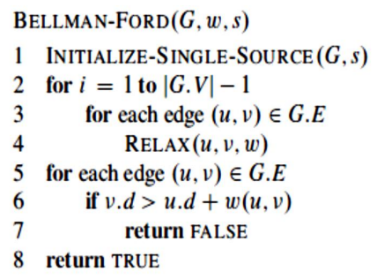
The Bellman-Ford algorithm runs in time O ( VE ) since the initialization in line 1 takes θ ( V ) time, each of the | V | - 1 passes over the edges in lines 2–4 takes time θ ( E ), and the for loop of lines 5–7 takes O ( E ) time.

Slide 95
Edges - 1-2, 1-4, 3-2, 4-3
4
5 5 -10
3
1
2
4
3

Slide 96
Edges - 1-2, 1-4, 3-2, 4-3
4
5 5 -10
3
5+3-10= -2 Negative Weight Cycle
1
2
4
3

Slide 97
4
5 -10
8
1
2
4
3

Slide 98
Edges - 1-2, 1-4, 3-2, 4-3
4
5 -10
8
1
2
4
3

Slide 99
Edges - 1-2, 1-4, 3-2, 4-3
4 ∞
5 -10
∞ ∞ 8
1
2
4
3

Slide 100
Edges - 1-2, 1-4, 4-3, 3-2
4 ∞ 4 3
5 -10
5 ∞ ∞ 13 8
Relax –
1-2 = 4
1-4 = 5
4-3 = 13
3-2 = 3
1
2
4
3

Slide 101
Edges - 1-2, 1-4, 4-3, 3-2
4 ∞ 4 3
5 -10
5 ∞ ∞ 13 8
Relax –
1st iteration 2nd iteration
1-2 = 4 1-2 = 4/3 = 3
1-4 = 5 1-4 = 5
4-3 = 13 4-3 = 13
3-2 = 3 3-2 = 3
1
2
4
3

Slide 102
-1
2
5
6 -2 1 3
5
5 -2 3
-1
1
3
7
4
6

Slide 103
Edges – 1-2, 1-3, 1-4, 2-5, 3-2, 3-5, 4-3, 4-6, 5-7, 6-7 ∞ -1 ∞
2
5
6 -2 1 3
5 ∞ ∞
5 -2 3
∞ -1 ∞
1
3
7
4
6

Slide 104
Edges – 1-2, 1-3, 1-4, 2-5, 3-2, 3-5, 4-3, 4-6, 5-7, 6-7 ∞ 6 -1 ∞
2
5
6 -2 1 3
5 ∞ ∞
5 -2 3
∞ -1 ∞
1
3
7
4
6

Slide 105
Edges – 1-2, 1-3, 1-4, 2-5, 3-2, 3-5, 4-3, 4-6, 5-7, 6-7 ∞ 6 -1 ∞
2
5
6 -2 1 3
5 ∞ 5 ∞
5 -2 3
∞ -1 ∞
1
3
7
4
6

Slide 106
Edges – 1-2, 1-3, 1-4, 2-5, 3-2, 3-5, 4-3, 4-6, 5-7, 6-7 ∞ 6 -1 ∞
2
5
6 -2 1 3
5 ∞ 5 ∞
5 -2 3
∞ 5 -1 ∞
1
3
7
4
6

Slide 107
Edges – 1-2, 1-3, 1-4, 2-5, 3-2, 3-5, 4-3, 4-6, 5-7, 6-7 ∞ 6 -1 ∞ 5
2
5
6 -2 1 3
5 ∞ 5 ∞
5 -2 3
∞ 5 -1 ∞
1
3
7
4
6

Slide 108
Edges – 1-2, 1-3, 1-4, 2-5, 3-2, 3-5, 4-3, 4-6, 5-7, 6-7 3 ∞ 6 -1 ∞ 5
2
5
6 -2 1 3
5 ∞ 5 ∞
5 -2 3
∞ 5 -1 ∞
1
3
7
4
6

Slide 109
Edges – 1-2, 1-3, 1-4, 2-5, 3-2, 3-5, 4-3, 4-6, 5-7, 6-7 3 ∞ 6 -1 ∞ 5
2
5
6 -2 1 3
5 ∞ 5 ∞
5 -2 3
∞ 5 -1 ∞
1
3
7
4
6

Slide 110
Edges – 1-2, 1-3, 1-4, 2-5, 3-2, 3-5, 4-3, 4-6, 5-7, 6-7 3 ∞ 6 -1 ∞ 5
2
5
6 -2 1 3
5 ∞ 5 3 ∞
5 -2 3
∞ 5 -1 ∞
1
3
7
4
6

Slide 111
Edges – 1-2, 1-3, 1-4, 2-5, 3-2, 3-5, 4-3, 4-6, 5-7, 6-7 3 ∞ 6 -1 ∞ 5
2
5
6 -2 1 3
5 ∞ 5 3 ∞
5 -2 3
∞ 5 -1 ∞ 4
1
3
7
4
6

Slide 112
Edges – 1-2, 1-3, 1-4, 2-5, 3-2, 3-5, 4-3, 4-6, 5-7, 6-7 3 ∞ 6 -1 ∞ 5
2
5
6 -2 1 3
5 ∞ 5 3 ∞ 8
5 -2 3
∞ 5 -1 ∞ 4
1
3
7
4
6

Slide 113
Edges – 1-2, 1-3, 1-4, 2-5, 3-2, 3-5, 4-3, 4-6, 5-7, 6-7 3 ∞ 6 -1 ∞ 5
2
5
6 -2 1 3
5 ∞ 5 3 ∞ 8 7
5 -2 3
∞ 5 -1 ∞ 4
1
3
7
4
6

Slide 114
Edges – 1-2, 1-3, 1-4, 2-5, 3-2, 3-5, 4-3, 4-6, 5-7, 6-7 3 ∞ 6 -1 ∞ 5
2
5
6 -2 1 3
5 ∞ 5 3 ∞ 8 7
5 -2 3
∞ 5 -1 ∞ 4
2nd iteration
1
3
7
4
6

Slide 115
Edges – 1-2, 1-3, 1-4, 2-5, 3-2, 3-5, 4-3, 4-6, 5-7, 6-7 3 ∞ 6 -1 ∞ 5
2
5
6 -2 1 3
5 ∞ 5 3 ∞ 8 7
5 -2 3
∞ 5 -1 ∞ 4
2nd iteration
1
3
7
4
6

Slide 116
Edges – 1-2, 1-3, 1-4, 2-5, 3-2, 3-5, 4-3, 4-6, 5-7, 6-7 3 ∞ 6 -1 ∞ 5
2
5
6 -2 1 3
5 ∞ 5 3 ∞ 8 7
5 -2 3
∞ 5 -1 ∞ 4
2nd iteration
1
3
7
4
6

Slide 117
Edges – 1-2, 1-3, 1-4, 2-5, 3-2, 3-5, 4-3, 4-6, 5-7, 6-7 3 ∞ 6 -1 ∞ 5 2
2
5
6 -2 1 3
5 ∞ 5 3 ∞ 8 7
5 -2 3
∞ 5 -1 ∞ 4
2nd iteration
1
3
7
4
6

Slide 118
Edges – 1-2, 1-3, 1-4, 2-5, 3-2, 3-5, 4-3, 4-6, 5-7, 6-7 3 1 ∞ 6 -1 ∞ 5 2
2
5
6 -2 1 3
5 ∞ 5 3 ∞ 8 7
5 -2 3
∞ 5 -1 ∞ 4
2nd iteration
1
3
7
4
6

Slide 119
Edges – 1-2, 1-3, 1-4, 2-5, 3-2, 3-5, 4-3, 4-6, 5-7, 6-7 3 1 ∞ 6 -1 ∞ 5 2
2
5
6 -2 1 3
5 ∞ 5 3 ∞ 8 7
5 -2 3
∞ 5 -1 ∞ 4
2nd iteration
1
3
7
4
6

Slide 120
Edges – 1-2, 1-3, 1-4, 2-5, 3-2, 3-5, 4-3, 4-6, 5-7, 6-7 3 1 ∞ 6 -1 ∞ 5 2
2
5
6 -2 1 3
5 ∞ 5 3 ∞ 8 7
5 -2 3
∞ 5 -1 ∞ 4
2nd iteration
1
3
7
4
6

Slide 121
Edges – 1-2, 1-3, 1-4, 2-5, 3-2, 3-5, 4-3, 4-6, 5-7, 6-7 3 1 ∞ 6 -1 ∞ 5 2
2
5
6 -2 1 3
5 ∞ 5 3 ∞ 8 7
5 -2 3
∞ 5 -1 ∞ 4
2nd iteration
1
3
7
4
6

Slide 122
Edges – 1-2, 1-3, 1-4, 2-5, 3-2, 3-5, 4-3, 4-6, 5-7, 6-7 3 1 ∞ 6 -1 ∞ 5 2
2
5
6 -2 1 3
5 ∞ 5 3 ∞ 8 7 5
5 -2 3
∞ 5 -1 ∞ 4
2nd iteration
1
3
7
4
6

Slide 123
Edges – 1-2, 1-3, 1-4, 2-5, 3-2, 3-5, 4-3, 4-6, 5-7, 6-7 3 1 ∞ 6 -1 ∞ 5 2
2
5
6 -2 1 3
5 ∞ 5 3 ∞ 8 7 5
5 -2 3
∞ 5 -1 ∞ 4
2nd iteration
1
3
7
4
6

Slide 124
Edges – 1-2, 1-3, 1-4, 2-5, 3-2, 3-5, 4-3, 4-6, 5-7, 6-7 3 1 ∞ 6 -1 ∞ 5 2
2
5
6 -2 1 3
5 ∞ 5 3 ∞ 8 7 5
5 -2 3
∞ 5 -1 ∞ 4
3rd iteration
1
3
7
4
6

Slide 125
Edges – 1-2, 1-3, 1-4, 2-5, 3-2, 3-5, 4-3, 4-6, 5-7, 6-7 3 1 ∞ 6 -1 ∞ 5 2
2
5
6 -2 1 3
5 ∞ 5 3 ∞ 8 7 5
5 -2 3
∞ 5 -1 ∞ 4
3rd iteration
1
3
7
4
6

Slide 126
Edges – 1-2, 1-3, 1-4, 2-5, 3-2, 3-5, 4-3, 4-6, 5-7, 6-7 3 1 ∞ 6 -1 ∞ 5 2 0
2
5
6 -2 1 3
5 ∞ 5 3 ∞ 8 7 5
5 -2 3
∞ 5 -1 ∞ 4
3rd iteration
1
3
7
4
6

Slide 127
Edges – 1-2, 1-3, 1-4, 2-5, 3-2, 3-5, 4-3, 4-6, 5-7, 6-7 3 1 ∞ 6 -1 ∞ 5 2 0
2
5
6 -2 1 3
5 ∞ 5 3 ∞ 8 7 5
5 -2 3
∞ 5 -1 ∞ 4
3rd iteration
1
3
7
4
6

Slide 128
Edges – 1-2, 1-3, 1-4, 2-5, 3-2, 3-5, 4-3, 4-6, 5-7, 6-7 3 1 ∞ 6 -1 ∞ 5 2 0
2
5
6 -2 1 3
5 ∞ 5 3 ∞ 8 7 5
3
5 -2 3
∞ 5 -1 ∞ 4
3rd iteration
1
3
7
4
6

Slide 129
Edges – 1-2, 1-3, 1-4, 2-5, 3-2, 3-5, 4-3, 4-6, 5-7, 6-7 3 1 ∞ 6 -1 ∞ 5 2 0
2
5
6 -2 1 3
5 ∞ 5 3 ∞ 8 7 5
3
5 -2 3
∞ 5 -1 ∞ 4
3rd iteration
1
3
7
4
6

Slide 130
Edges – 1-2, 1-3, 1-4, 2-5, 3-2, 3-5, 4-3, 4-6, 5-7, 6-7 3 1 ∞ 6 -1 ∞ 5 2 0
2
5
6 -2 1 3
5 ∞ 5 3 ∞ 8 7 5
3
5 -2 3
∞ 5 -1 ∞ 4
4th iteration No Change
1
3
7
4
6

Slide 131
Edges – 1-2, 1-3, 1-4, 2-5, 3-2, 3-5, 4-3, 4-6, 5-7, 6-7 3 1 ∞ 6 -1 ∞ 5 2 0
2
5
6 -2 1 3
5 ∞ 5 3 ∞ 8 7 5
3
5 -2 3
∞ 5 -1 ∞ 4
5th , 6th iteration No Change
1
3
7
4
6

Slide 132
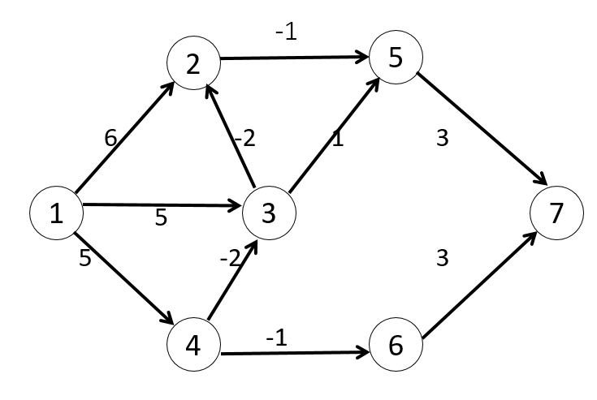
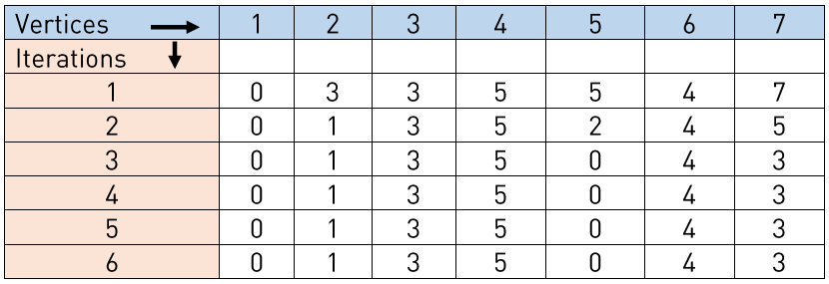

Slide 135
Multistage Graph – cost (i,j) = min { c(j,k) + cost(i+1,k) }
4
1 11 18
9
2 5 13
5 16 2
2
A
D
S
B
E
T
C
F

Slide 137
Travelling salesman problem
0 | 10 | 15 | 20
5 | 0 | 9 | 10
6 | 13 | 0 | 12
8 | 8 | 9 | 0
G ( i, s) = min { Ci j + g( j , S{ j } ) }

Slide 138
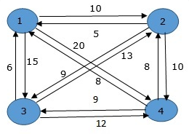
Travelling salesman problem

Slide 139
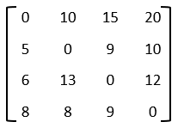
If size of S is 2, then S must be {1, i},
C(S, i) = dist(1, i)
Else if size of S is greater than 2.
C(S, i) = min { C(S-{i}, j) + dis(j, i)} where j belongs to S, j != i and j != 1.
G ( i, S) = min { C i j + g( j , S- { j } )
j Є S
Analysis: There are at the most 2n.n sub-problems and each one takes linear time to solve. Therefore, the total running time is O(2n.n2)

Slide 140
G ( i, S) = min { C i j + g( j , S- { j } )
j Є S

Slide 141
G ( i, S) = min { C i j + g( j , S- { j } )
j Є S

Slide 142
G ( i, S) = min { C i j + g( j , S- { j } )
j Є S

Slide 143
TSP

